Slide 1
CAPSTONE PROJECT
TEAM - 1
TEAM MEMBERS:
Vishnu Sathyan
Arjun Shilin
Augustine
Mohammad Faiz
Parvathy Madhu
Aryamol Ashokan

Slide 2
TABLE OF CONTENTS
01
02
03
04
05
DOCUMENTion
protractor
selinium
integration
Jenkins+GIT
Write test plan, test strategy ,test case for deals of the week
module in urbanladder and créate ppt’s for
Mockito,grafana,
zephyr
Test the module deals of the week using protractor
Selenium web driver testcases to locate the elements of Urban ladder webpages. To depict the wait, sleep during the implementation
Cucumber + TestNG + Selenium integration to test the module of urban ladder. To imbibe the lighthouse or google axe tools.
Jenkins+selinium+git integration to check the module deals of the week in urban Ladder website
2

Slide 3
TABLE OF CONTENTS
06
07
08
09
10
Aws + jmeter
restassurd
MOBILE TESTING
SELINIUM + AWS
Python
Performance check for the module of urban ladder using JMeter on AWS cloud
API testing on sample spring boot application using rest assured
To depict Appium + selenium for mobile testing(Android) using emulator
Integrating aws with Jenkins and git
Selinium web driver automation testing using Python
3

Slide 4

Task 1
Click here
Write test plan, test strategy ,test case for deals of the week module in urbanladder.com
Presented by Aryamol Ashokan, Parvathy and Arjun

Slide 5
MOCKITO
Mockito is an open source Java-based mocking framework used for unit testing of Java application.
It is used to create simple and basic test API’s for performing unit testing of java applications
The main purpose of using the Mockito is to simplify the development of a test by mocking external dependencies and use them in the test code.
As a result, it provides a simpler test code that is easier to read, understand, and modify.
We can also use Mockito with JUnit and TestNG.
Notes:
https://www.guru99.com/what-everybody-ought-to-know-about-test-planing.html

Slide 6
MOCKITO ENVIRONMENT SETUP
Step 1 − Verify Java Installation on Your Machine (Open Command Console c:\> java -version)
If you do not have Java installed, To install the Java Software Development Kit (SDK)
Step 2 − Set JAVA Environment
Set the environment variable JAVA_HOME to C:\Program Files\Java\jdk1.6.0_21
Append the location of the Java compiler to your System Path
Append the string ;C:\Program Files\Java\jdk1.6.0_21\bin to the end of the system variable, Path.
Verify Java Installation using the command java -version as explained above.
Step 3 − Download Mockito-All Archive
To download the latest version of Mockito from Maven Repository .
Step 4 − Set Mockito Environment
Set the environment variable Mockito HOME to C:\Mockito
Step 5 − Set CLASSPATH Variable
Set the environment variable CLASSPATH to %CLASSPATH%;%Mockito HOME%\mockito-all-2.0.2-beta.jar;.;
Notes:
https://www.guru99.com/what-everybody-ought-to-know-about-test-planing.html

Slide 7
MOCKITO
Step 6 − Download JUnit Archive
Download the latest version of JUnit jar file from
Save the folder at the location C:\>Junit.
Step 7 − Set JUnit Environment
Set the JUNIT_HOME environment variable to point to the base directory location where JUnit jars are stored on your machine.
Set the environment variable JUNIT_HOME to C:\JUNIT
Step 8 − Set CLASSPATH Variable
Set the CLASSPATH environment variable to point to the JUNIT jar location.
Set the environment variable CLASSPATH to %CLASSPATH%;%JUNIT_HOME%\junit4.11.jar;%JUNIT_HOME%\hamcrest-core-1.2.1.jar;.;
Notes:
https://www.guru99.com/what-everybody-ought-to-know-about-test-planing.html

Slide 8
GRAFANA
Grafana is open source visualization and analytics software.
It enables us to create a dashboard for collecting, processing, storing, and analyzing data from various different sources.
It will provide charts graphs and alert for the web
It will process the large amount of data and monitor
It allows you to query, visualize, alert on, and explore your metrics, logs, and traces no matter where they are stored.
It provides you with tools to turn your time-series database data into insightful graphs and visualizations.
It help us to track the user behavior, application behavior, freaquency and types of error and contextual scenarios by providing relative data
Notes:
https://www.guru99.com/what-everybody-ought-to-know-about-test-planing.html

Slide 9
HOW TO SETUP GRAFANA
Download the installer and run it.
http://localhost:3000 port will open grafana
By deafult Username: admin & Password : admin
Click the + icon on the side menu.
On the dashboard, click Add an empty panel.
In the New dashboard/Edit panel view, go to the Query tab.
Configure your query by selecting -- Grafana -- from the data source selector. This generates the Random Walk dashboard.
Click the Save icon in the top right corner of your screen to save the dashboard.
Add a descriptive name, and then click Save.
This is the first dashboard and you can see the result
Notes:
https://www.guru99.com/what-everybody-ought-to-know-about-test-planing.html

Slide 10
WHAT IS ZEPHYR
Zephyr is a testing solution that improves the quality of your software by managing and monitoring end-to-end testing.
Zephyr for Jira
Zephyr for Jira enables us to manage our test directly in Jira
Testing is incorporated into the project cycles and it permits you to track software quality and make empowered decisions.
Create, Plan, and Execute Tests
Create, view, and modify test steps.
Build test execution cycles.
Execute the tests and link defects to specific tests.
Track Quality of the test cases
It provides a simple dashboard that consists of testing metrics on the testing activities throughout every project.
Notes:
https://www.guru99.com/what-everybody-ought-to-know-about-test-planing.html

Slide 11
SETUP OF ZEPHYR INSIDE JIRA
Installation:
Sign up - Try Atlassian Cloud | Atlassian
Install JIRA and inside JIRA look for Apps and search for Zephyr for JIRA to be plugged in
We can add Test items as tickets to your Jira projects, link them to other Jira issues, plan your testing efforts by using test cycles, and track your testing efforts via metrics and reports.
Notes:
https://www.guru99.com/what-everybody-ought-to-know-about-test-planing.html

Slide 12
SETUP OF ZEPHYR INSIDE JIRA
Zephyr simplifies the testing process as test cases are organized under Jira tickets.
A user typically adds a test case by setting the ticket type to ‘Test’.
Once the ticket test is added with the appropriate title, description, and other relevant information, the user has the opportunity to update Actions, Details, and Execution.
Users can execute an added test case or add to the test cycle directly from the test case.
In ‘Details,’ users have the ability to edit/update the test steps. ‘Execute’ will display all the past executions related to the test case.
Notes:
https://www.guru99.com/what-everybody-ought-to-know-about-test-planing.html

Slide 13
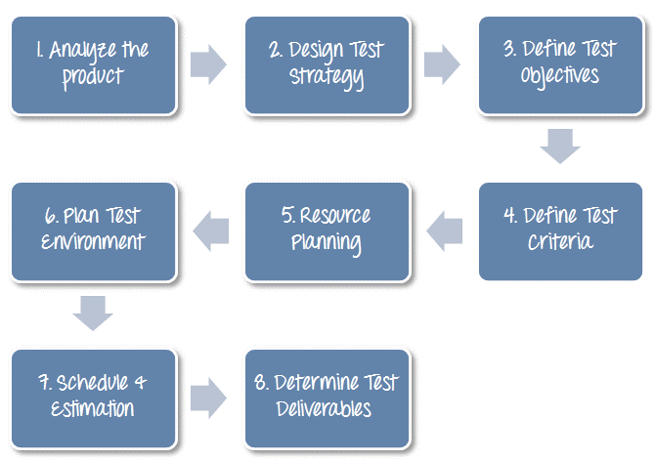
TEST PLAN
Detailed document that describes the test strategy, objectives, schedule, estimation, deliverables, and resources required to perform testing for a software product
Click here
Notes:
https://www.guru99.com/what-everybody-ought-to-know-about-test-planing.html

Slide 14
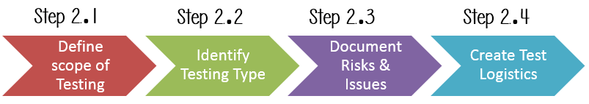
TEST STRATEGY
Well-described document in software testing which clearly defines the exact software testing approach and testing objectives of the software application.
Click here

Slide 15
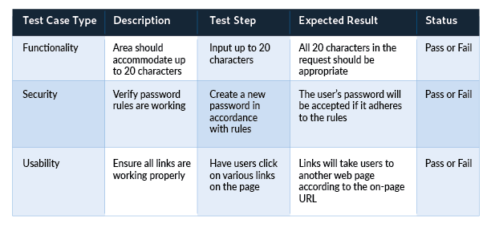
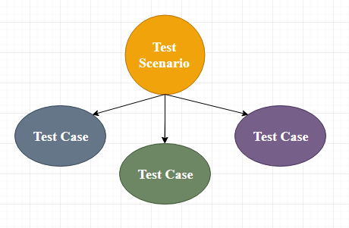
TEST CASE
Set of actions executed to verify a particular feature or functionality of the software application.
Click here

Slide 16
Task 2
Test the module deals of the week using protractor
Presented by Aryamol Ashokan

Slide 17
PROTRACTOR
Protractor is a wrapper around Selenium Web driver that provides an automation test framework, which simulates user interaction with an Angular web application
Protractor needs two files to run, a spec file and configuration file.
Configuration file: This File helps protractor to where the test files are placed (specs.js) and to talk with Selenium server (Selenium Address). Chrome is the default browser for Protractor.
Spec file: This File contains the logic and locators to interact with the application.

Slide 18
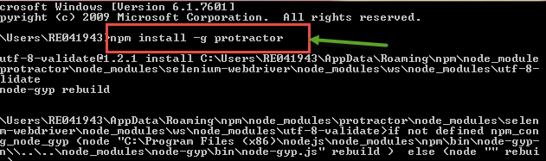

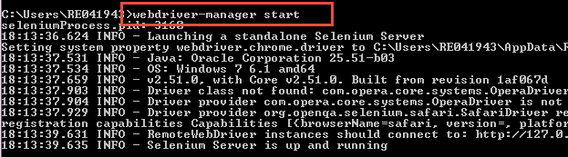
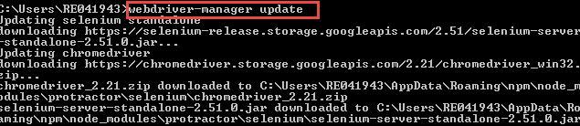
PROTRACTOR INSTALLATION
Open command prompt and type “npm install –g protractor”
Check the installation and version using “Protractor –version.”
Update the Web driver manager using the command “webdriver-manager update”
Start the Web driver manager using the command “webdriver-manager start”

Slide 19
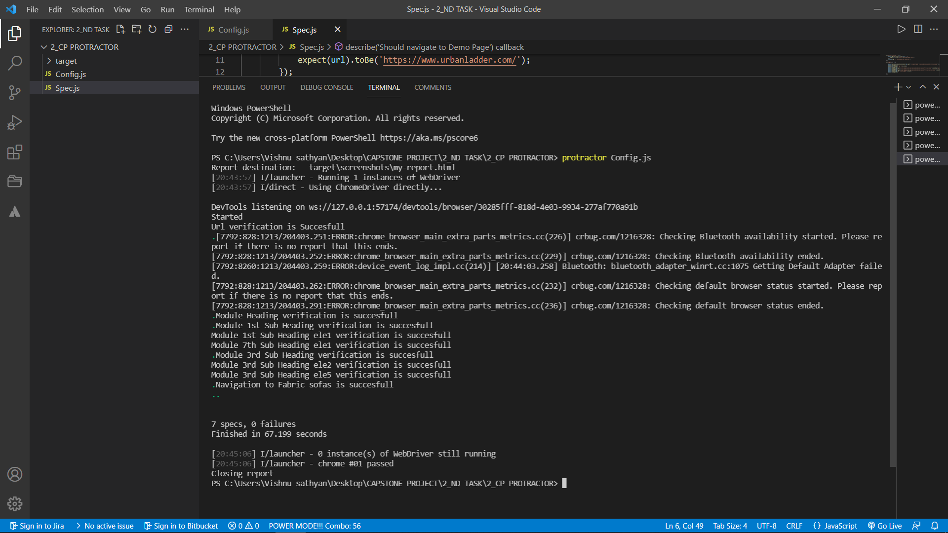

Slide 20
Task 3
Selenium web driver testcases to locate the elements of Urban ladder webpages. To depict the wait, sleep during the implementation
Presented by Mohammad Faiz

Slide 21
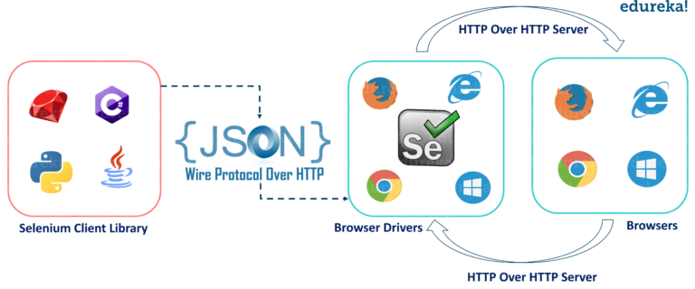
SELENIUM
Selenium is a free (open-source) automated testing framework used to validate web applications across different browsers and platforms. we can use multiple programming languages like Java, C#, Python etc. to create Selenium Test Scripts.

Slide 22
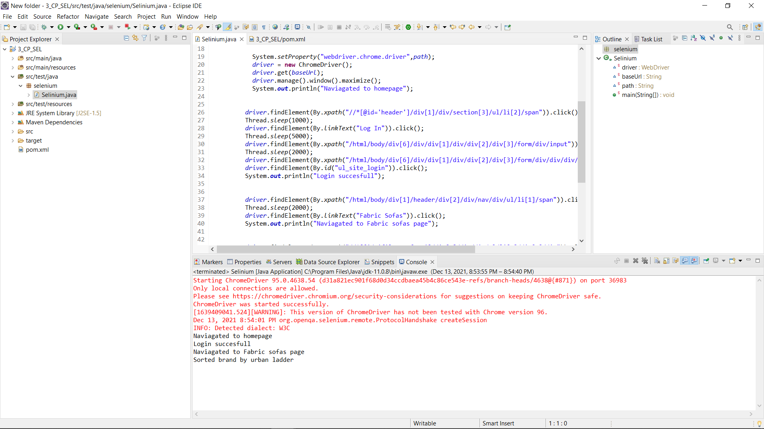

Slide 23
Task 4
Cucumber + TestNG + Selenium integration to test the module of urban ladder. To imbibe the lighthouse or google axe tools.
Presented by Mohammad Faiz

Slide 24
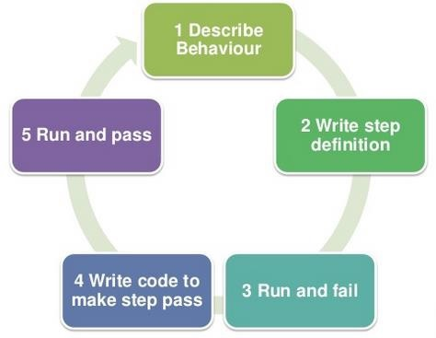
CUCUMBER
Cucumber is a software tool used by the testers to develop test cases for testing the behavior of the software.(BDD TOOL)
In the Cucumber testing, the test cases are written in a simple English text, which anybody can understand without any technical knowledge. This simple English text is called the Gherkin language.

Slide 25
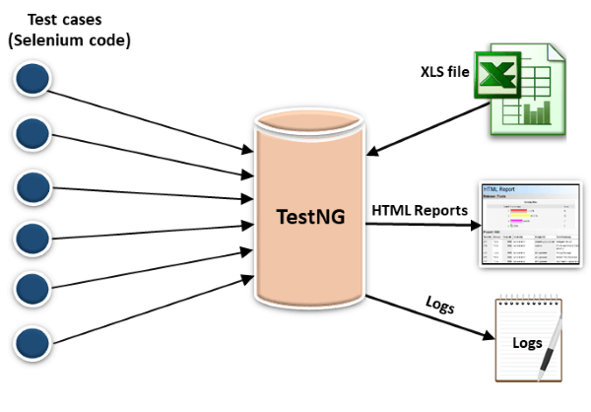
TESTNG
TestNG provides full control over the test cases and the execution of the test cases. Due to this reason, TestNG is also known as a testing framework.

Slide 26
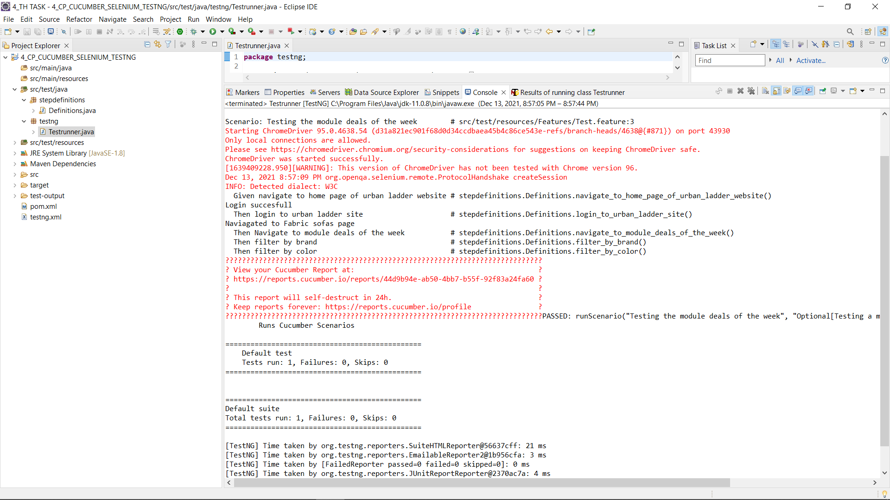

Slide 27
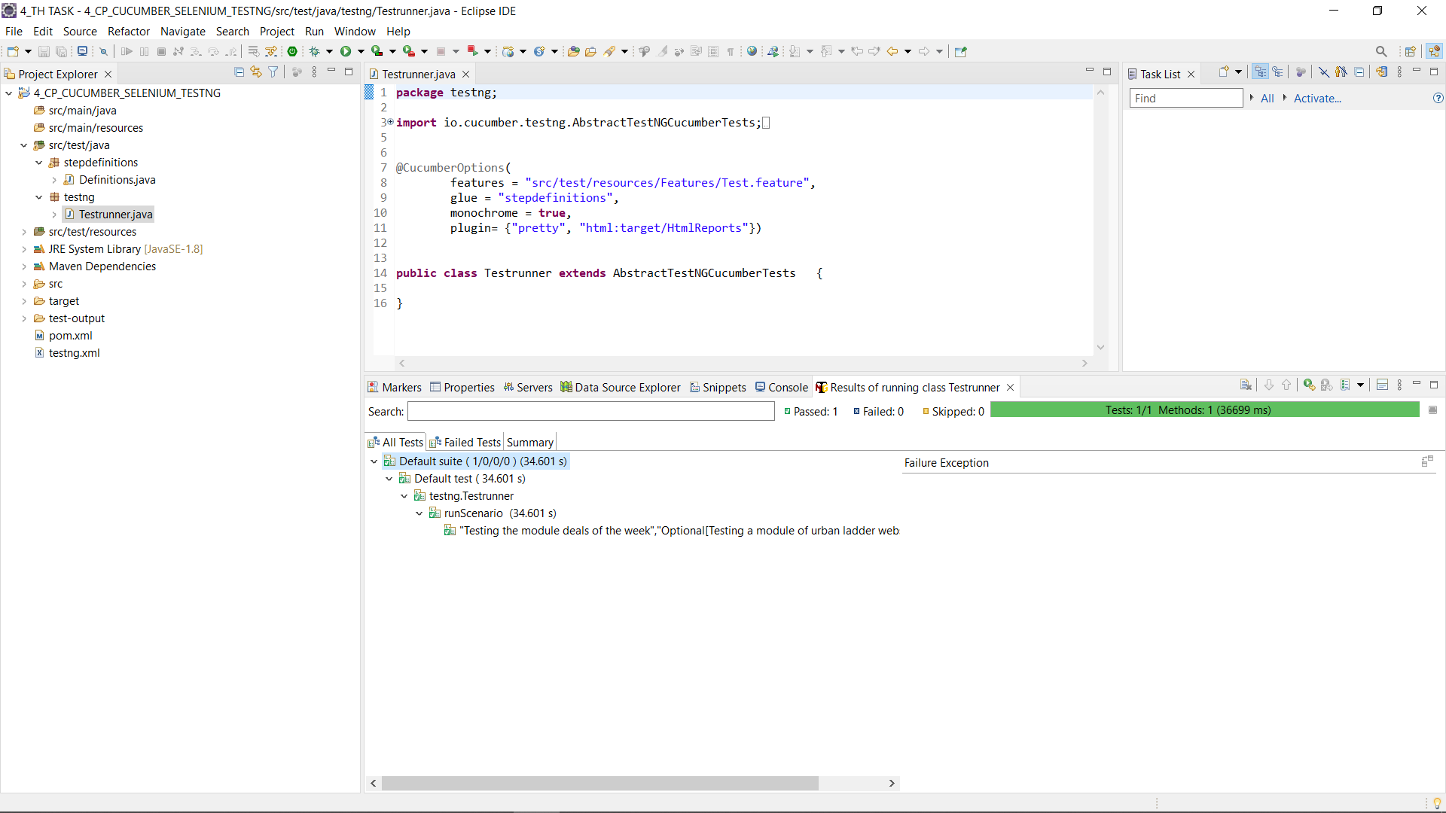

Slide 28
LIGHTHOUSE
Lighthouse is an open-source, automated tool for improving the performance, quality, and correctness of your web apps.
When auditing a page, Lighthouse runs a barrage of tests against the page, and then generates a report on how well the page did.
From here we can use the failing tests as indicators on what you can do to improve your app
It’s a browser extension
Click here

Slide 29
GOOGLE AXE TOOOLS
Axe DevTools includes tools that perform accessibility testing for web apps, native iOS and native Android.
Axe DevTools is a toolkit for finding, preventing and fixing accessibility defects in the code.
The free Chrome extension provides incredible insight into likely issues
Click here

Slide 30
Task 5
Jenkins+selinium+git integration to check the module deals of the week in urban Ladder website
Presented by Parvathy

Slide 31

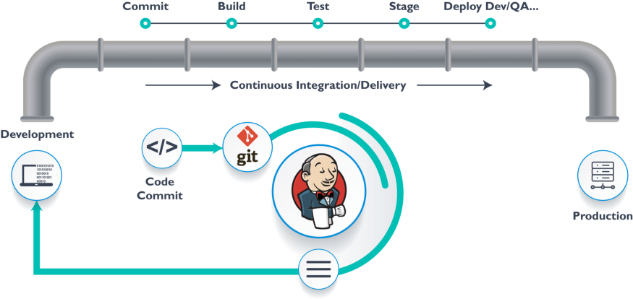
JENKINS
Jenkins is an open source continuous integration/continuous delivery and deployment (CI/CD) automation software DevOps tool written in the Java programming language. It is used to implement CI/CD workflows, called pipelines.
Click here

Slide 32
Task 6
Performance check for the module of urban ladder using JMeter on AWS cloud
Presented by Arjun

Slide 33
JMETER ON AWS
Apache JMeter is pure Java-based open-source software designed to load test functional behavior and measure performance.
JMeter can be also used to analyze and measure the performance of web applications or a variety of services.
Amazon web service is an online platform that provides scalable and cost-effective cloud computing solutions.
AWS is a broadly adopted cloud platform that offers several on-demand operations like compute power, database storage, content delivery, etc., to help corporates scale and grow
JMeter+AWS
JMeter UI

Slide 34
Task 7
API testing on sample spring boot application using rest assured
Presented by Vishnu Sathyan

Slide 35
REST ASSURED
One of the most used library for REST API Automation Testing.
Rest-Assured is a Java-based library that is used to test RESTful Web Services. This library behaves like a headless Client to access REST web services.
Rest-Assured library also provides the ability to validate the HTTP Responses received from the server
we can verify the Status code, Status message, Headers and even the Body of the response.

Slide 36
Task 8
To depict Appium + selenium for mobile testing(Android) using emulator
Presented by Vishnu Sathyan

Slide 37
APPIUM
APPIUM is a freely distributed open source mobile application UI Testing framework
Appium allows native, hybrid and web application testing and supports automation test on physical devices as well as an emulator or simulator both.
It offers cross-platform application testing, i.e. single API works for both Android and iOS platform test scripts.

Slide 38
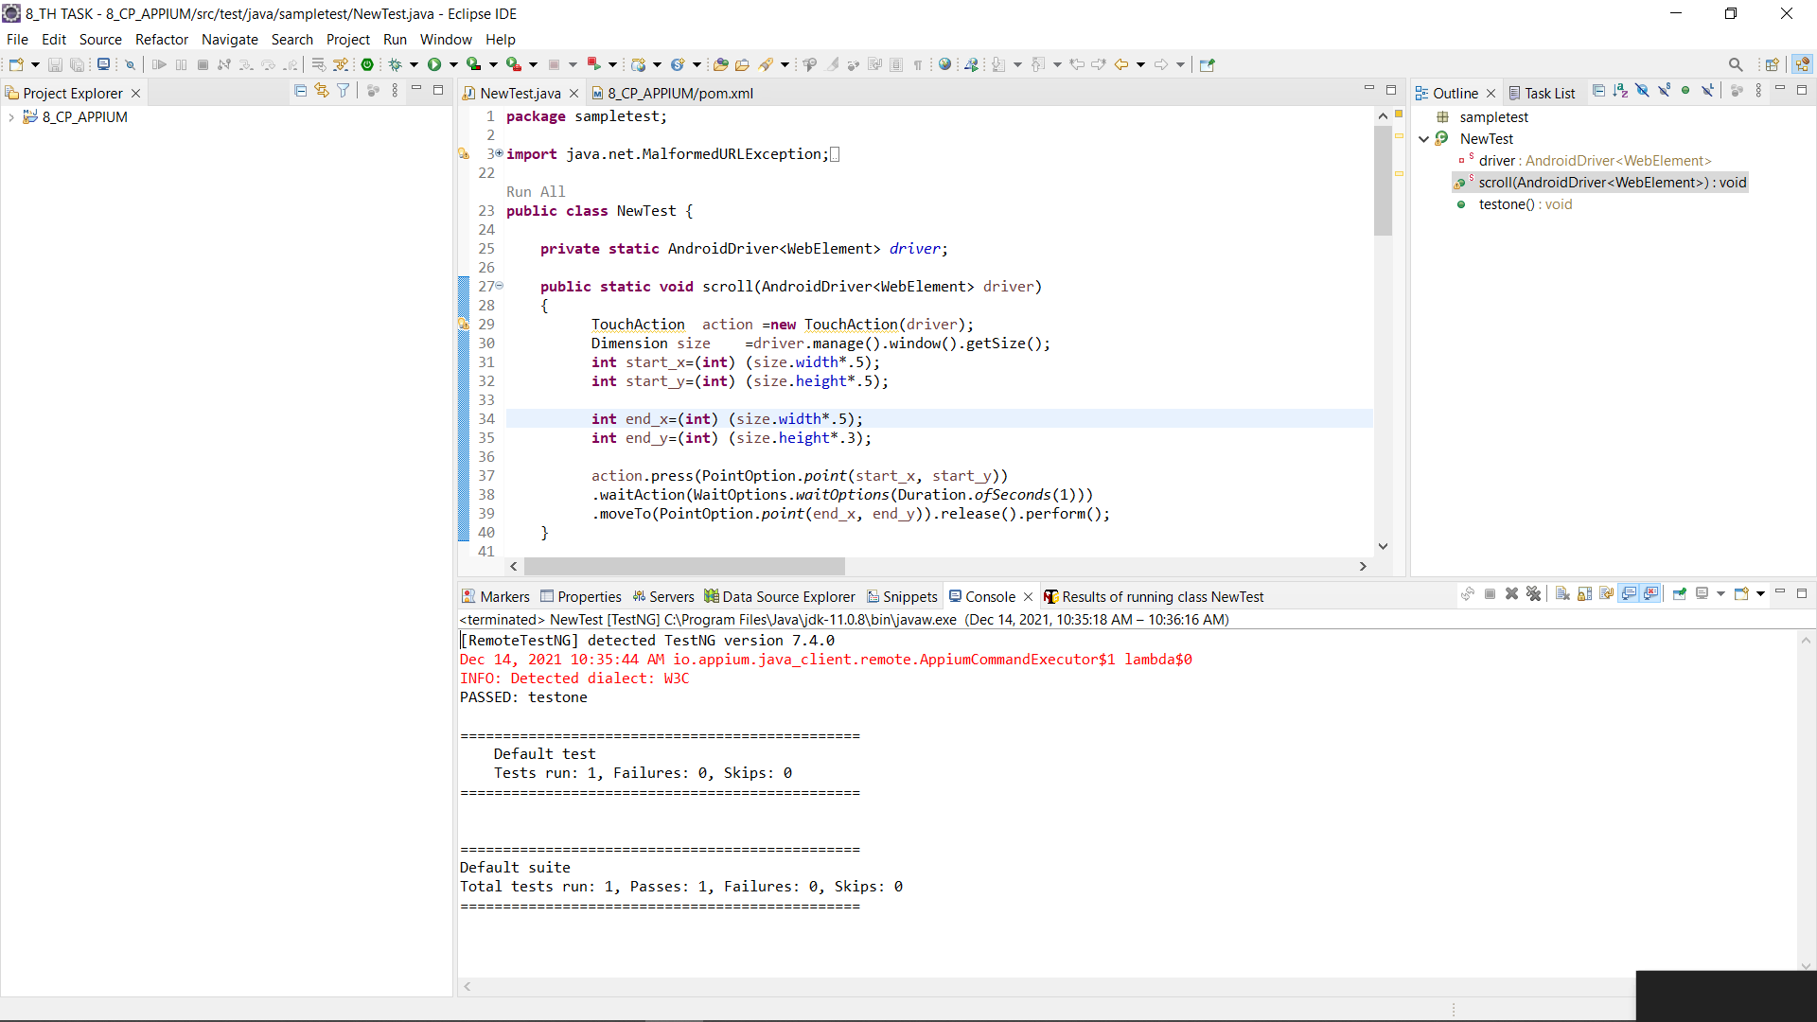

Slide 39
Task 9
Integrating AWS+JENKINS+GIT
Presented by Vishnu Sathyan
Aws +Jenkins

Slide 40
Task 10
Click here
Selinium web driver automation testing using Python
Presented by Augustine

Slide 41
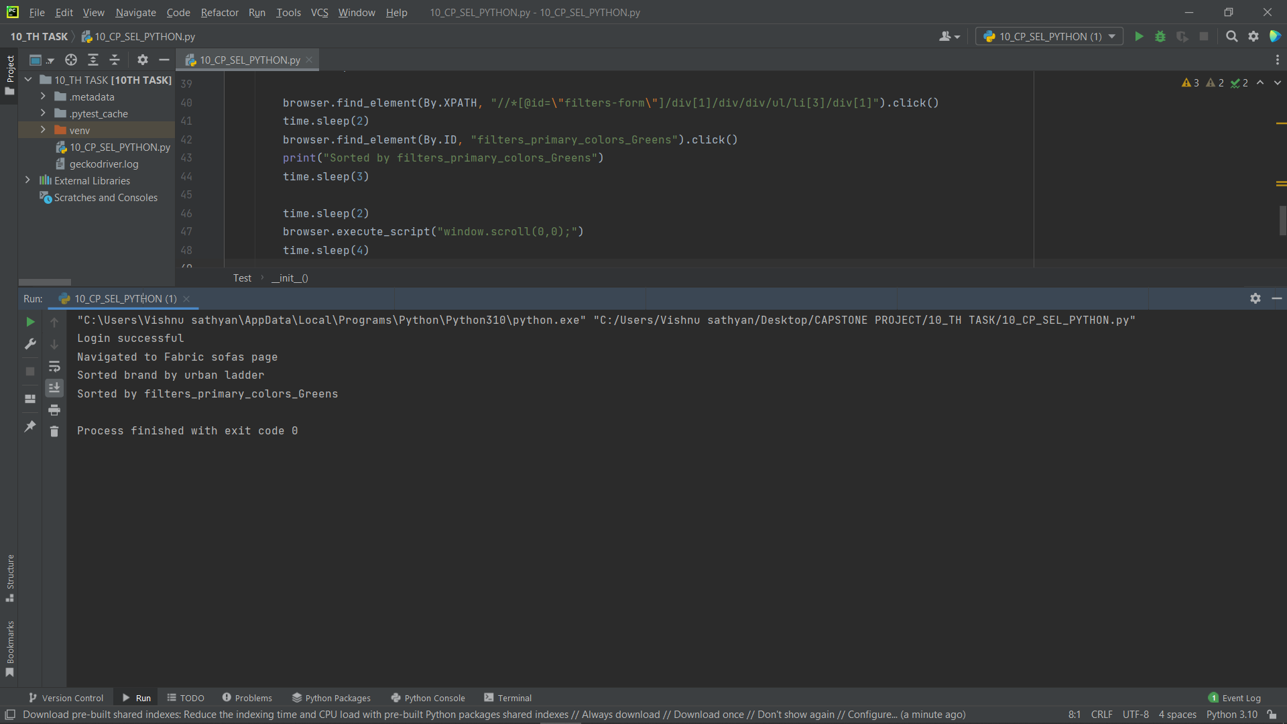

Slide 42
Reference
GitHub link to reference the code related to different tasks

Slide 43
GitHub link
Click here

Slide 44
Thank You 1

